Slide 1
Innovative test solution
Provider
- Probe pin Datasheet -

Slide 2
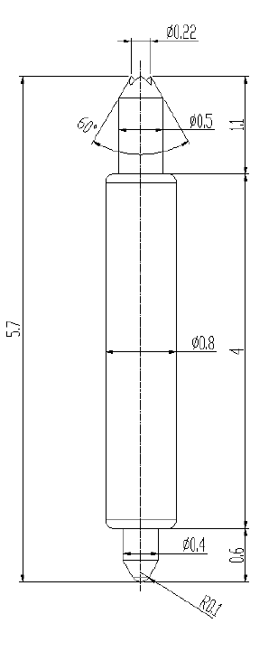
※ General POGO pin – 5.7mm / 1.0P
IVB-DZR-570-080-A220-00
Pitch | 1.0mm
Total Length | 5.7mm
Use Length | 5.05mm
Use Stroke | 0.65mm
Spring Force at Use Stroke | 25gf at 0.65mm Stroke
Operating Temperature | -45 to 140°C
DC Resistance | 50.0mΩ at 0.65mm stroke
Current Rating | 3.5 A (Continuous)
Self Inductance | 1.4 nH
Bandwidth @ -1dB | 7.1 GHz
Top Plunger | BeCu / Au over Ni
Bottom Plunger | BeCu / Au over Ni
Barrel | PBT / Au over Ni
Spring | Stainless Steel / Au
Insertion Life | 100,000 cycles at 0.65mm Stroke

Slide 3
Thank you.

